Slide 1

Copilot Studio Integration with SharePoint Files Exploring Integration Strategies and Trade offs
Company confidential

Slide 2
Copilot Studio Solution Options
01
Direct Integration with SharePoint
02
Sync SharePoint Files using Power Automate Flow
03
Sync SharePoint Files with ADF (Event Trigger)
04
Conversion of PPT files to PDF in Sharepoint

Slide 3
Limitations & Assumptions
3 MB File Size Limitation with Copilot Studio
Consider Azure Open AI with Azure Storage Account as knowledge source
Need reliable solution for large size files in SharePoint
Need reliable & optimize solution for high frequency of uploading files in SharePoint
Major Trade-off: Missing user permissions with Storage approach
Allowed network traffic between Power Platform to Microsoft Azure
Allowed network traffic between Microsoft Azure to SharePoint

Slide 4








Option 1: Direct SharePoint Integration
Copilot User Interface / Channels
Knowledge Sources
Site with SFF and TFF Documents
MS Teams
Copilot Studio
MS Teams
Feature Demonstration
List with Point of Contacts
Gen Answers on External Site
Gen Answers on SharePoint Docs
Copilot Suggestions
Teams Integration
Ability to Start Conversation with SPOC / Channel in Teams
Barclays ESG Website
Custom Copilot Built
Using Copilot Studio
Copilot Studio Features Leveraged
Topics and Conversational Boosting
Active Directory SSO
Power Platform Flows
Adaptive Cards
Intelligent Authoring
SharePoint File Level Permissions
Graph API Integration
Publishing to Channels
Backend Services
Entra ID
MS Graph
Power Platform
MS Teams

Slide 5
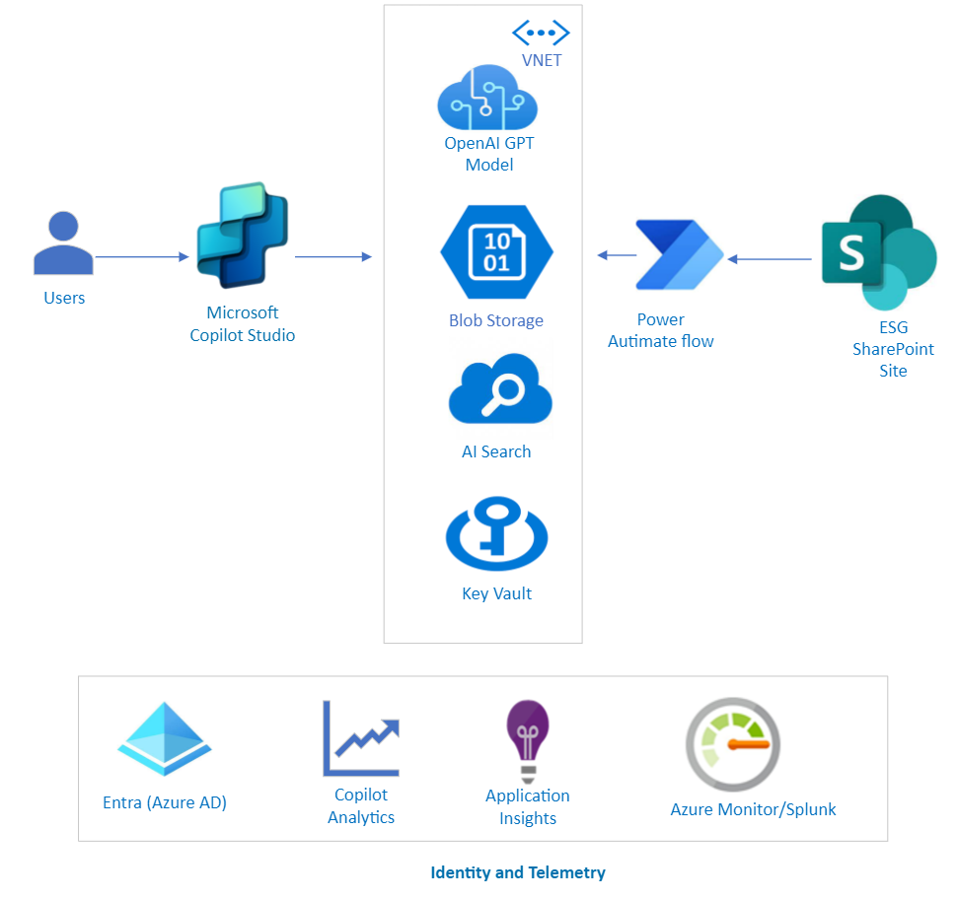
Option 2: Sync SharePoint Files using Power Automate Flow

Slide 6
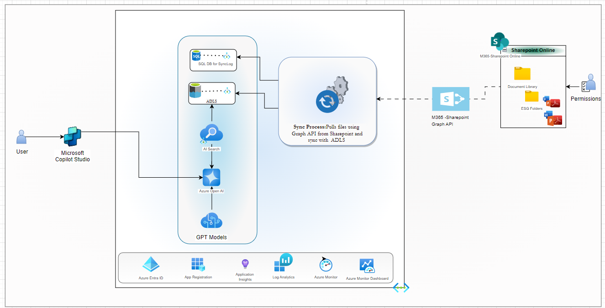
Option 3: Sync SharePoint Files with ADF (Event Trigger)

Slide 7
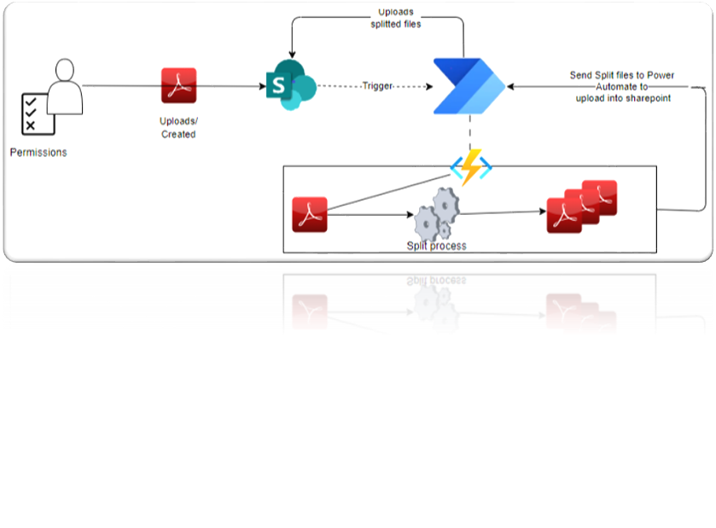
Split Files using Power Automate Flow – Instant Trigger
Power Automate Flow call Azure function to split PDF files based on Size up to 3 MB when File is created or updated in SharePoint.
Azure Function will split PDF files based on size up to 3 MB.
Azure function and Power Automate cost will be involved.
Consider upload PDF chunks to SharePoint directly from Azure function for better performance.
If upload PDF chunks in SharePoint from Power Automate flow, PDF chunks are uploaded with user context.

Slide 8
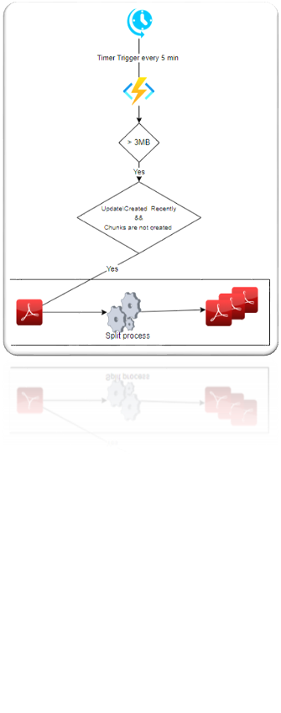
Split Files using Azure Function – Timer Trigger
Trigger Azure Function to split Large PDF files with Timer Trigger​
Azure Function will split PDF files based on size up to 3 MB and upload files to SharePoint​
Azure function and Power Automate cost will be involved.​
Consider upload PDF chunks to SharePoint directly from Azure function for better performance.​
Files are upload using Service account context. File level permissions are removed.

Slide 9
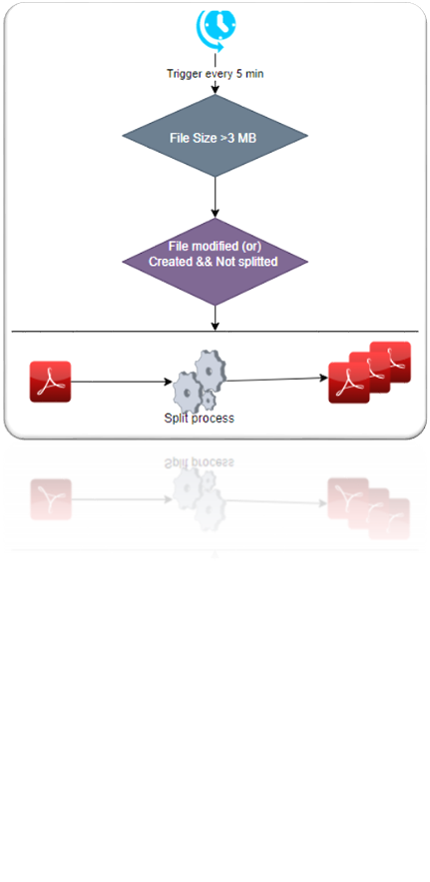
Split PDF files using .NET library and Sync Files using OneDrive​
Triggers PDF splitting process by scheduler . ​
OneDrive will sync PDF chunks to SharePoint without any additional efforts with Service account context ​
Dedicated VM is required for this option. VM Cost will be added.

Slide 10
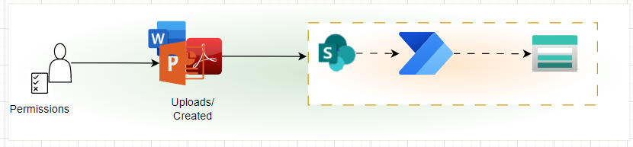
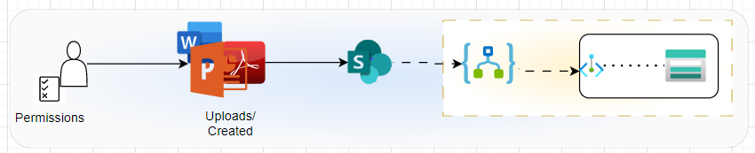
Simple Strategies using Power Automate/Logic Apps
Simple and easy to transfer SharePoint files to Azure Storage using Power Automate flow
Trade-offs :
Not directly support connecting Azure Storage through Private endpoint
Not support if copy large files (>100 MB)
Simple and easy to transfer SharePoint files to Azure Storage using Logic Apps
Supported connecting Azure Storage through Private endpoint
Trade-offs :
Not support if copy large files (>100 MB)

Slide 11
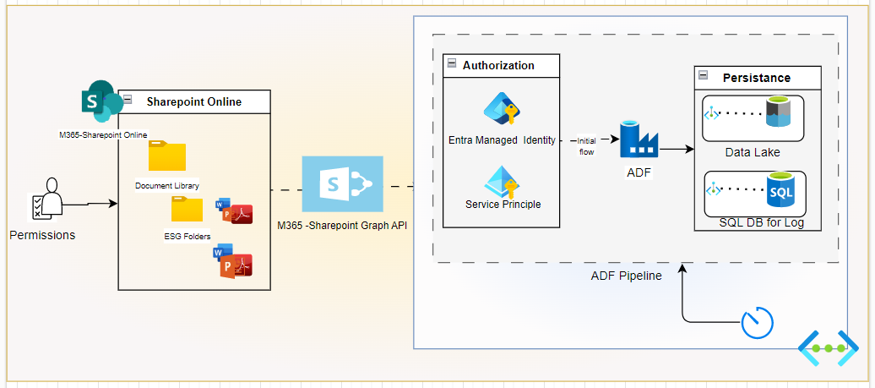
Sync SharePoint Files with ADF (Timer Trigger)
Supported transferring large SharePoint files to Azure Storage Account (or) ADLS.
Supported connecting Azure Storage through Private endpoint.
Selectively files-based type of document and Modified date using SharePoint Graph API with Service Principle (or) Managed Identity Authorization
Logged Metadata details of files
Pulled only Delta files in Subsequent request
Trade-offs :
Expertise required to implement ADF pipeline
ADF Pipeline triggered even No changes in SharePoint.

Slide 12
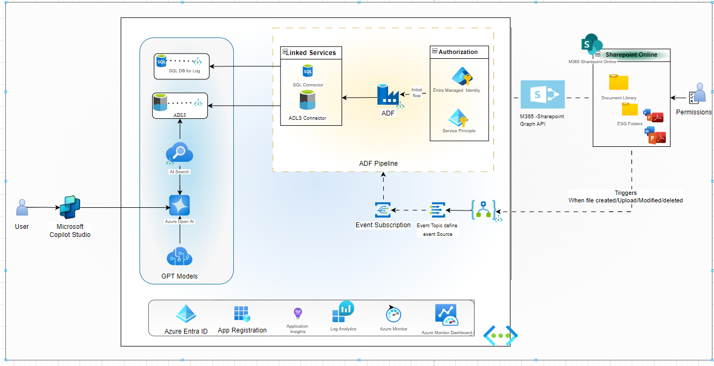
Sync SharePoint Files with ADF (Event based Trigger)

Slide 13
Options Comparison
Criteria | Option1: Direct SharePoint Integration + Split File Solution | Option2: Sync SharePoint Files using Power Automate | Option 3: Sync SharePoint Files Using Azure Data Factory and Triggers
File Size for Generative Answers | Files are split, Larger than 3 MB | up to 100 MB | up to 100 MB
File Size Limitation for Sync from SharePoint to MS Azure | NA | Support file size < 100 MB | Supports file size > 100 MB
Complexity of Implementation | Simple | Simple | Additional Development and maintenance effort for ADF pipelines and Logic apps
Permissions | User permissions are retained as in SharePoint | Permissions to be managed at Copilot level | Permissions to be managed at Copilot level
LLM Model | GPT 3.5 Turbo | Optional(GPT 3.5 Turbo, GPT 4 and other models) | Optional(GPT 3.5 Turbo, GPT 4 and other models)
LLM Model Customizations | Limited Customization Options | Additional Model customizations | Additional Model customizations
Cost | 200 USD/25K messages | Cost estimate is based on the LLM Model, number of tokens and Azure AI Search | Cost estimate is based on the LLM Model, number of tokens and Azure AI Search

Slide 14
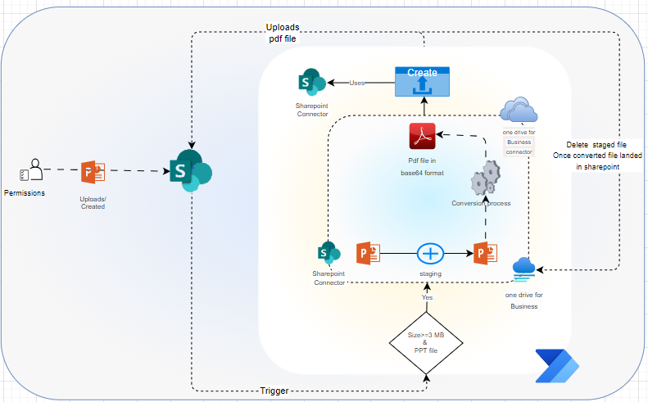
Conversion of PPT file to PDF file (> =3MB) using OneDrive Converter
Conversion flow will be triggered only when file size > = 3Mb and file type is PowerPoint presentation
compress images while converting into PDF
Get high compression and less size compared to other conversions
No Additional Cost.
Trade-offs :
Still, it is in preview.
Additional Step to Stage file in One Drive from SharePoint.
Another additional step to clean staged file after conversion.
Throwing exceptions for some files while converting file with error code PPTCannotInstallFonts.
Error: Conversion of this file to PDF is not supported (invalidFileFormat / Error from Office Service.
Even no guarantee on file size always less than 3 MB. Depends upon size of the input file.
Example: 70 MB size presentation file converted as 2.8 MB size PDF file using this connector.
Notes:
In the Conversion Flow:
We used the OneDrive converter activity to convert PowerPoint presentation files to PDF.
Flow Trigger:
The flow is triggered when a new presentation file is uploaded to SharePoint and the file size is greater than or equal to 3 MB.
OneDrive Convert Activity:
The “OneDrive Convert” activity works only with files in OneDrive, necessitating two additional activities:
Stage the file in OneDrive using the content from the SharePoint file before initiating the conversion process.
The conversion process will create a converted PDF in OneDrive, which will then be created in SharePoint.
A cleaning activity will remove the staged PPT file from OneDrive after the converted PDF file is created in SharePoint.
Advantages:
The OneDrive Convert activity compresses images during the conversion to PDF.
This Conversion flow results in higher compression and smaller file sizes compared to other methods.
As it is a Microsoft service, there is no additional cost.
Trade-offs:
The “OneDrive Convert file” activity is currently in public preview.
It only works with files located in OneDrive, requiring additional steps to stage files from SharePoint and to clean up files from OneDrive after the conversion.
Error occurred
Error: Conversion of this file to PDF is not supported. (invalidFileFormat / Error from Office Service) with invalid fonts.
Final Slide:
I will present statistics to compare the size of the initial PPT file versus the converted PDF file and the time taken for conversion compared to other strategies.

Slide 15
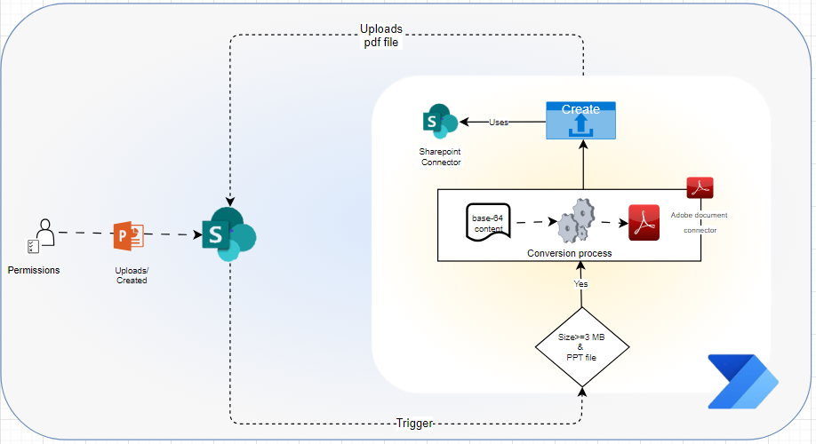
Conversion of PPT file to PDF file (> =3MB) using Adobe Connector
Conversion flow will be triggered only when file size > =3 and file type is PowerPoint presentation
Trade-offs :
Even no guarantee on file size always less than 3 MB. Depends upon size of the input file
Example: 47 MB size presentation file converted as 8 MB size PDF file
Additional cost with this Third-party connector
It is free up to 500 transaction per month in free tier.
Exclude this non-Business connector from DLP Policy to make it work
Notes:
Conversion Flow:
We used the Adobe converter activity to convert files from PPT to PDF.
Flow:
The flow is triggered when a new presentation file is uploaded to SharePoint and the size of the file is greater than or equal to 3 MB.
The conversion process is then triggered in the flow.
The converted file will be created in SharePoint.
Trade-offs:
The Adobe Convert file activity is currently in public preview.
There is an additional cost associated with this service.
To make it work, exclude this non-Business connector from the DLP Policy.
Final Slide:
I will present statistics comparing the size of the initial file versus the converted file and the time taken for conversion among other strategies.
----------------
In this Conversion Flow, We used Adobe converter activity to convert files from PPT to PDF.
Flow : flow will be triggered when new presentation file is upload in SharePoint and also size of the file is greater than or equal to 3 MB.
And then Triggered Conversion process in the flow .
And then Converted file will be created in SharePoint.
Trade-offs are :
Adobe Convert file activity is in public preview.
Additional Cost
Exclude this non-Business connector from DLP Policy to make it work
In the last slide , I will show statics with size of initial file vs converted file and time taken among remaining conversion strategies..

Slide 16
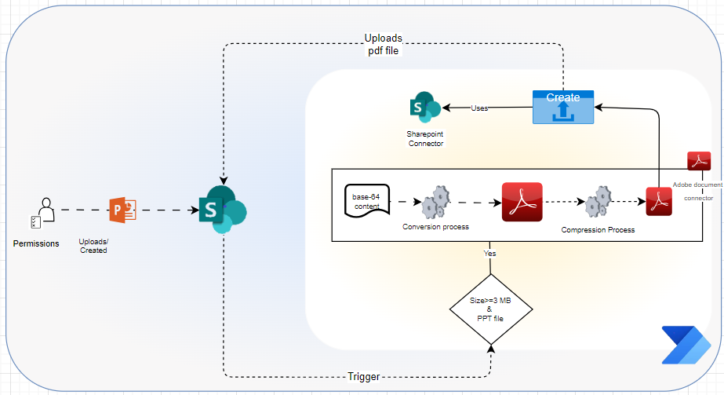
Conversion of PPT file to PDF file (> =3MB) using Adobe Connector
Conversion flow will be triggered only when file size > =3 and file type is PowerPoint presentation
This connector will compress images while converting into PDF
Best result with Converted PDF file along with Compression.
Trade-offs :
Even no guarantee on file size always less than 3 MB. Depends upon size of the input file
Example: 47 MB size presentation file converted as 8 MB size PDF file
Additional cost with this Third-party connector
It is free up to 500 transaction per month in free tier.
Exclude this non-Business connector from DLP Policy to make it work
Notes:
Conversion Flow:
We used the Adobe converter activity and compression activity to convert files from PPT to PDF.
Flow:
The flow is triggered when a new presentation file is uploaded to SharePoint and the size of the file is greater than or equal to 3 MB.
The conversion process is then triggered in the flow, converting the PPT file to PDF.
The file is then compressed using Adobe compression.
The converted and compressed file will be created in SharePoint.
The best results are achieved with the converted PDF file along with compression.
Trade-offs:
The Adobe Convert file activity is currently in public preview.
There is an additional cost associated with this service.
To make it work, exclude this non-Business connector from the DLP Policy.
Final Slide:
I will present statistics comparing the size of the initial file versus the converted file and the time taken for conversion.
----------------------- In this Conversion Flow, We used Adobe converter activity and compression activity to convert files from PPT to PDF.
Flow : flow will be triggered when new presentation file is upload in SharePoint and also size of the file is greater than or equal to 3 MB.
And then Triggered Conversion process in the flow so PPT file will be converted as PDF.
And then it will be compressed by using Adope compressed
And then Converted and compressed file will be created in SharePoint.
Trade-offs are :
Adobe Convert file activity is in public preview.
Additional Cost
Exclude this non-Business connector from DLP Policy to make it work
In the last slide , I will show statics with size of initial file vs converted file and time taken for conversion.

Slide 17
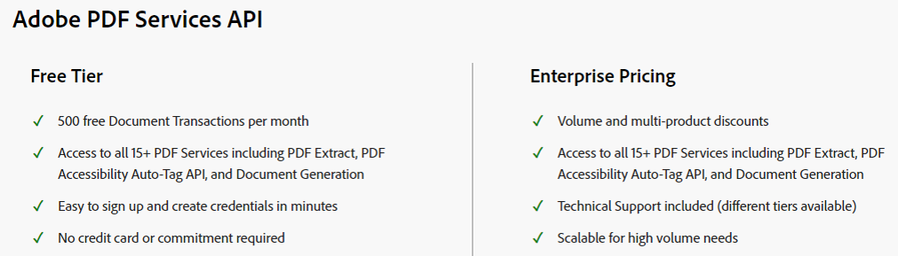
Adobe Acrobat Services Pricing
Licensing and Usage Limits
https://learn.microsoft.com/en-us/connectors/adobepdftools/

Slide 18
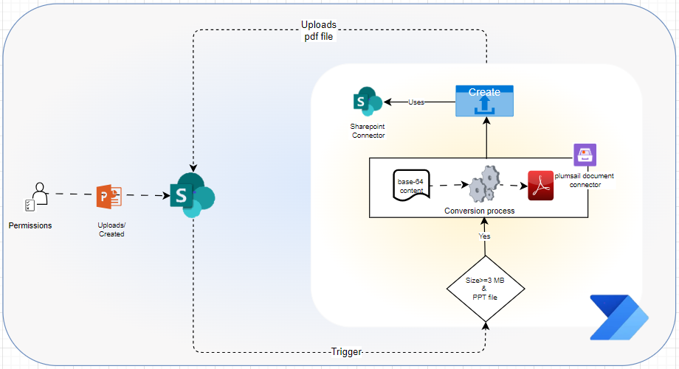
Conversion of PPT file to PDF file (> =3MB) using Plumsail Connector
Conversion flow will be triggered only when file size > =3Mb and file type is PowerPoint presentation
This connector will compress images while converting into PDF
Trade-offs :
Even no guarantee on file size less than 3 MB. Depends upon input file size
Example:47 MB size presentation file converted as 8 MB size PDF file
Notes:
Conversion Flow:
We used the Plumsail document converter activity to convert files from PPT to PDF.
Flow:
The flow is triggered when a new presentation file is uploaded to SharePoint and the size of the file is greater than or equal to 3 MB.
The conversion process is then triggered in the flow.
The converted file will be created in SharePoint.
Trade-offs:
There is an additional cost associated with this service.
To make it work, exclude this non-Business connector from the DLP Policy.
Final Slide:
I will present statistics comparing the size of the initial file versus the converted file and the time taken for conversion among other strategies.

Slide 19
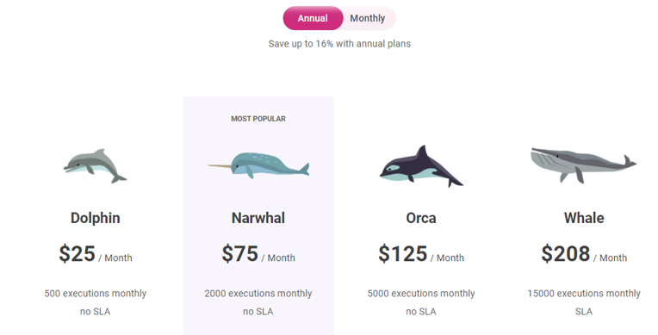
Plumsail Connector Pricing

Slide 20
Options Comparison
 |  | One Drive |  | Adobe |  | Adobe |  | plumsail |  | plumsail
 |  | Convert file (Preview) (or) Convert file using path (Preview) |  | Convert PPT to PDF (Preview) |  | Convert PPT to PDF (Preview) Compress PDF (Preview) |  | Convert PPTX to PDF |  | Convert PPTX to PDF Compress PDF document
Files used for Conversion | Original size | Size after conversion | Time taken | Size after conversion | Time taken | Size after conversion | Time taken | Size after conversion | Time taken | Size after conversion | Time taken
Sample-Slides_v3.pptx | 11.4 MB | 2.48 MB | 0.41 Sec | 1.76 MB | 0.26 sec | 787 KB | 0.31 Sec | 1.98 MB | 0.26 Sec | 1.95 MB | 0.41 Sec
Sample_v1.pptx | 7.42 MB | 3.01 MB | 0.48 sec | 3.50 MB | 0.40 Sec | 2.45 MB | 0.57 Sec | 4.43 MB | 0.43 Sec | 4.30 MB | 1.01 Sec
Sample_v11.pptx | 3.45 MB | 1.70 MB | 0.48 sec | 2.66 MB | 0.50 Sec | 2.12 MB | 1.05 Sec | 3.68 MB | 2.30 Sec | 3.55 MB | 0.59 Sec
Enable DLP Policy |  | No |  | Yes |  | Yes |  | Yes |  | Yes
Additional Cost |  | No |  | Yes |  | Yes |  | Yes |  | Yes
Native Connector |  | Yes |  | No |  | No |  | No |  | No
Stage and Clean Stage files |  | Yes |  | No |  | No |  | No |  | No
Remarks |  | Files to be staged before conversion and clean staged files after conversion |  |  |  | The level of compression are High, Medium , Low. The default is MEDIUM. Used High
Notes:
File Conversion Comparision:
Tested PPT to PDF file conversion process with various connectors and actions.
It details the original and post-conversion file sizes, along with the time taken for each action.
Performance Metrics:
The data indicates efficient conversion and compression, with significant size reduction and quick processing times.
Color-coded status indicators highlight the best and least conversion results..
Optimization Results:
The best outcomes are achieved with converted and compressed PDF files, ensuring high-quality results.
Conversion Connectors:
Multiple connectors like OneDrive, Adobe, and Plumsail are used for different stages of the conversion process.
Each connector has specific actions like ‘Convert PPT to PDF’ and ‘Compress PDF document’.
Compression Levels:
The level of compression can be adjusted, with options like High, Medium, and Low, to suit different needs.
Error Handling:
Errors like ‘Http 502 Gateway Error’ are displayed, indicating potential issues during the conversion process.

Slide 21
Options Comparison
 |  | One Drive |  | Adobe |  | Adobe |  | plumsail |  | plumsail |  | Encodian |  | Encodian |  | Encodian
 |  | Convert file (Preview) (or) Convert file using path (Preview) |  | Convert PPT to PDF (Preview) |  | Convert PPT to PDF (Preview) Compress PDF (Preview) |  | Convert PPTX to PDF |  | Convert PPTX to PDF Compress PDF document |  | Convert PowerPoint |  | Compress PowerPoint |  | Compress PowerPoint Convert PowerPoint Compress PDF
Files used for Conversion | Original size | Size after conversion | Time taken | Size after conversion | Time taken | Size after conversion | Time taken | Size after conversion | Time taken | Size after conversion | Time taken | Size after conversion | Time taken | Size after conversion | Time taken | Size after conversion | Time taken
Sample-Slides_v3.pptx | 11.4 MB | 2.48 MB | 0.41 Sec | 1.76 MB | 0.26 sec | 787 KB | 0.31 Sec | 1.98 MB | 0.26 Sec | 1.95 MB | 0.41 Sec |  |  | 17.8 MB | 1.03 Sec
Sample_v1.pptx | 7.42 MB | 3.01 MB | 0.48 sec | 3.50 MB | 0.40 Sec | 2.45 MB | 0.57 Sec | 4.43 MB | 0.43 Sec | 4.30 MB | 1.01 Sec |  |  | 10.4 MB | 0.48 Sec
Sample_v11.pptx | 3.45 MB | 1.70 MB | 0.48 sec | 2.66 MB | 0.50 Sec | 2.12 MB | 1.05 Sec | 3.68 MB | 2.30 Sec | 3.55 MB | 0.59 Sec |  |  | 5.01 MB | 0.34 Sec
Enable DLP Policy |  | No |  | Yes |  | Yes |  | Yes |  | Yes |  | Yes |  | Yes |  | Yes
Additional Cost |  | No |  | Yes |  | Yes |  | Yes |  | Yes |  | Yes |  | Yes |  | Yes
Native Connector |  | Yes |  | No |  | No |  | No |  | No |  | No |  | No |  | No
Stage and Clean Stage files |  | Yes |  | No |  | No |  | No |  | No |  | No |  | No |  | No
Remarks |  | Files to be staged before conversion and clean staged files after conversion |  |  |  | The level of compression are High, Medium , Low. The default is MEDIUM. Used High |  |  |  |  |  | Http 502 Gateway Error |  |  |  | Http 502 Gateway Error
Notes:
File Conversion Comparision:
Tested PPT to PDF file conversion process with various connectors and actions.
It details the original and post-conversion file sizes, along with the time taken for each action.
Performance Metrics:
The data indicates efficient conversion and compression, with significant size reduction and quick processing times.
Color-coded status indicators highlight the best and least conversion results..
Optimization Results:
The best outcomes are achieved with converted and compressed PDF files, ensuring high-quality results.
Conversion Connectors:
Multiple connectors like OneDrive, Adobe, and Plumsail are used for different stages of the conversion process.
Each connector has specific actions like ‘Convert PPT to PDF’ and ‘Compress PDF document’.
Compression Levels:
The level of compression can be adjusted, with options like High, Medium, and Low, to suit different needs.
Error Handling:
Errors like ‘Http 502 Gateway Error’ are displayed, indicating potential issues during the conversion process.

Slide 22
Options Comparison
Connectors | Actions | Files used in conversion | Original size | Size after conversion | Time taken | Remarks
One Drive | Convert file (Preview) (or) Convert file using path (Preview) | 2024.05 Risilience Slides_v3.pptx | 11.4 MB | 2.48 MB | 0.41 Sec | Files to be staged before conversion and clean staged files after conversion
 |  | Barclays ESG Strategy & Credentials_v1.pptx | 7.42 MB | 3.01 MB | 0.48 sec
 |  | Barclays ESG Strategy & Credentials_v11.pptx | 3.45 MB | 1.70 MB | 0.48 sec
Adobe | Convert PPT to PDF (Preview) | 2024.05 Risilience Slides_v3.pptx | 11.4 MB | 1.76 MB | 0.26 sec
 |  | Barclays ESG Strategy & Credentials_v1.pptx | 7.42 MB | 3.50 MB | 0.40 Sec
 |  | Barclays ESG Strategy & Credentials_v11.pptx | 3.45 MB | 2.66 MB | 0.50 Sec
Adobe | Convert PPT to PDF (Preview) Compress PDF (Preview) | 2024.05 Risilience Slides_v3.pptx | 11.4 MB | 787 KB | 0.31 Sec | The level of compression are High, Medium , Low. The default is MEDIUM. Used High
 |  | Barclays ESG Strategy & Credentials_v1.pptx | 7.42 MB | 2.45 MB | 0.57 Sec
 |  | Barclays ESG Strategy & Credentials_v11.pptx | 3.45 MB | 2.12 MB | 1.05 Sec
plumsail | Convert PPTX to PDF | 2024.05 Risilience Slides_v3.pptx | 11.4 MB | 1.98 MB | 0.26 Sec
 |  | Barclays ESG Strategy & Credentials_v1.pptx | 7.42 MB | 4.43 MB | 0.43 Sec
 |  | Barclays ESG Strategy & Credentials_v11.pptx | 3.45 MB | 3.68 MB | 2.30 Sec
plumsail | Convert PPTX to PDF Compress PDF document | 2024.05 Risilience Slides_v3.pptx | 11.4 MB | 1.95 MB | 0.41 Sec
 |  | Barclays ESG Strategy & Credentials_v1.pptx | 7.42 MB | 4.30 MB | 1.01 Sec
 |  | Barclays ESG Strategy & Credentials_v11.pptx | 3.45 MB | 3.55 MB | 0.59 Sec
Encodian | Convert PowerPoint | 2024.05 Risilience Slides_v3.pptx | 11.4 MB |  |  | Http 502 Gateway Error
 |  | Barclays ESG Strategy & Credentials_v1.pptx | 7.42 MB
 |  | Barclays ESG Strategy & Credentials_v11.pptx | 3.45 MB
Encodian | Compress PowerPoint | 2024.05 Risilience Slides_v3.pptx | 11.4 MB | 17.8 MB | 1.03 Sec
 |  | Barclays ESG Strategy & Credentials_v1.pptx | 7.42 MB | 10.4 MB | 0.48 Sec
 |  | Barclays ESG Strategy & Credentials_v11.pptx | 3.45 MB | 5.01 MB | 0.34 Sec
Encodian | Compress PowerPoint Convert PowerPoint Compress PDF | 2024.05 Risilience Slides_v3.pptx | 11.4 MB |  |  | Http 502 Gateway Error
 |  | Barclays ESG Strategy & Credentials_v1.pptx | 7.42 MB
 |  | Barclays ESG Strategy & Credentials_v11.pptx | 3.45 MB
Notes:
File Conversion Comparision:
Tested PPT to PDF file conversion process with various connectors and actions.
It details the original and post-conversion file sizes, along with the time taken for each action.
Performance Metrics:
The data indicates efficient conversion and compression, with significant size reduction and quick processing times.
Color-coded status indicators highlight the best and least conversion results..
Optimization Results:
The best outcomes are achieved with converted and compressed PDF files, ensuring high-quality results.
Conversion Connectors:
Multiple connectors like OneDrive, Adobe, and Plumsail are used for different stages of the conversion process.
Each connector has specific actions like ‘Convert PPT to PDF’ and ‘Compress PDF document’.
Compression Levels:
The level of compression can be adjusted, with options like High, Medium, and Low, to suit different needs.
Error Handling:
Errors like ‘Http 502 Gateway Error’ are displayed, indicating potential issues during the conversion process.

Slide 23
About Capgemini
Capgemini is a global business and technology transformation partner, helping organizations to accelerate their dual transition to a digital and sustainable world, while creating tangible impact for enterprises and society. It is a responsible and diverse group of 340,000 team members in more than 50 countries. With its strong over 55-year heritage, Capgemini is trusted by its clients to unlock the value of technology to address the entire breadth of their business needs. It delivers end-to-end services and solutions leveraging strengths from strategy and design to engineering, all fueled by its market leading capabilities in AI, cloud and data, combined with its deep industry expertise and partner ecosystem. The Group reported 2023 global revenues of €22.5 billion.
Get the future you want | www.capgemini.com

